Slide 1

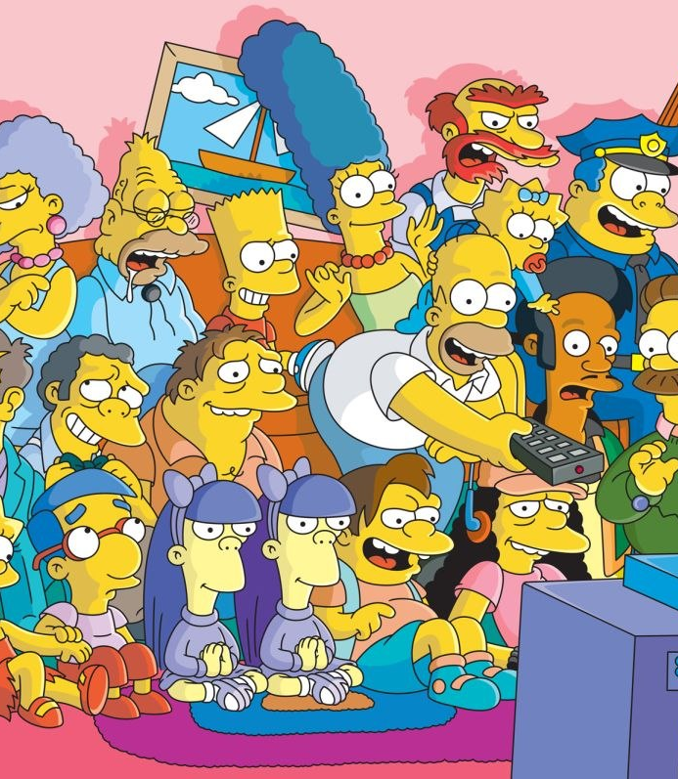
Image Detection of Simpsons Characters
DAEN 690 Project
Summer 2019
Manju Prasad, Ravi Rane, Zegang Liu, Yinchen Niu

Slide 2
Analytics / Algorithms
Sprint 3 – Week 3 Presentation
9th July 2019

Slide 3
Project Sprints
Sprint
Milestone Goals
Presentation
Problem Definition and Project Plans
Problem (decision) defined
Understanding of complexity
Potential data source identified
Potential analytics identified
Project schedule defined
Participant roles assigned
Risks identified and mitigation plan
Mid-Sprint 28 May; Full Sprint 4 Jun
Data Sets
Data located and accessed
Initial processing underway
Risks identified and mitigated
Mid-sprint 11 Jun;
Full Sprint 18 Jun
Analytics/algorithms
Algorithms defined and coded
Initial applications completed
Risks identified and mitigated
Mid-sprint 25 Jun
& 2 Jul;
Full Sprint 9 Jul
Visualizations
Visualization concepts defined
Visualization implemented
Risks identified and mitigated
Mid-sprint 16 Jul;
Full Sprint 23 Jul
Mid-Sprint 30 July;
Full Sprint 6 Aug
Final Presentations
Project components completed
Project components integrated
Project supports final decision
Presentation made

Slide 4
Project Schedule
Project Timeline:
Core Project Scope – Development.
Aided by learning Neural Networks
Notes:
Suggest we concentrate on Metadata and NLP and NOT Externals other than what results from associations between metadata and content

Slide 5
Sprint Goals
Show your research and deep dive into proposed models and algorithms.
Show the mathematics and statistics supporting your algorithms.
Show your implementations and comparison of algorithms.
Test and validate your model with actual historical observations.
Discuss what metrics you would use to assert your results.
Present your incremental and final results.
Early presentation and visualization effort.

Slide 6
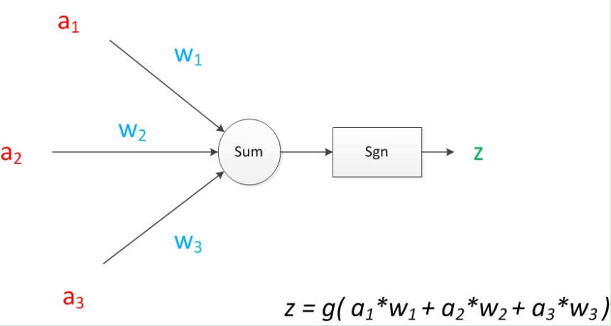
Research and Deep dive into algorithms
CNN:
A kind of artificial intelligence machine learning technology. It has three basic layers: Convolutional Layer, Pooling Layer, Flatten Layer & Fully Connected.
Based on the analysis of each character, build a model to identify each character in the simpsons
Advantages: Sharing convolution kernel, no pressure for processing high-dimensional data.
Ddisadvantages: Need a large samples. And the pooling layer may lose some valuable information and ignore the correlation between the parts and the whole.

Slide 7
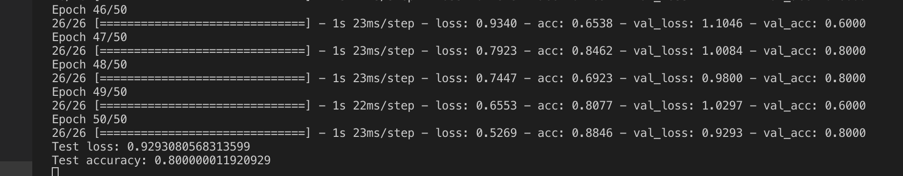
CNN - Execution Log
From ARGO:

Slide 8
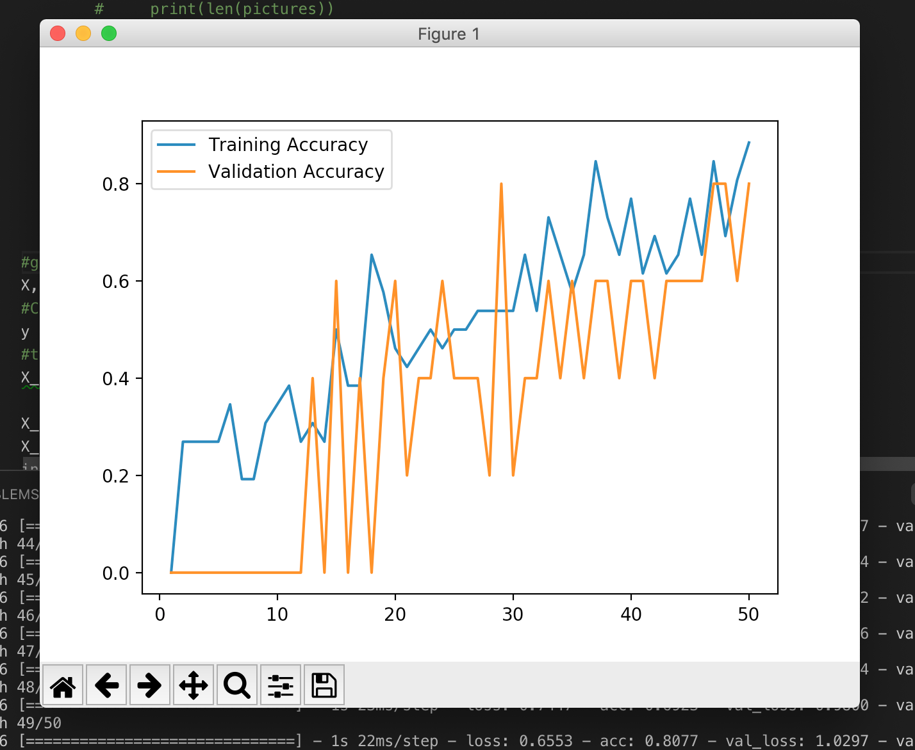
CNN - Performance for Small Dataset

Slide 9
Research and Deep dive into algorithms
Faster R CNN:
Faster R-CNN: Real-Time Object Detection with Region Proposal Networks.
Successor of RCNN and Fast RCNN.
Fast RCNN Selective search: slow and time consuming process
Faster RCNN Replaces the selective search method with region proposal network which made the algorithm much faster.
Region Proposal Network: takes image feature maps as an input and generates a set of object proposals, each with an object ness score as output
A RoI pooling layer is applied on these proposals to bring down all the proposals to the same size.
The algorithm requires many passes through a single image to extract all the objects.
Object proposal takes time and as there are different systems working one after the other, the performance of systems depends on how the previous system has performed.
The proposals are passed to a fully connected layer which has a softmax layer and a linear regression layer at its top, to classify and output the bounding boxes for objects.

Slide 10
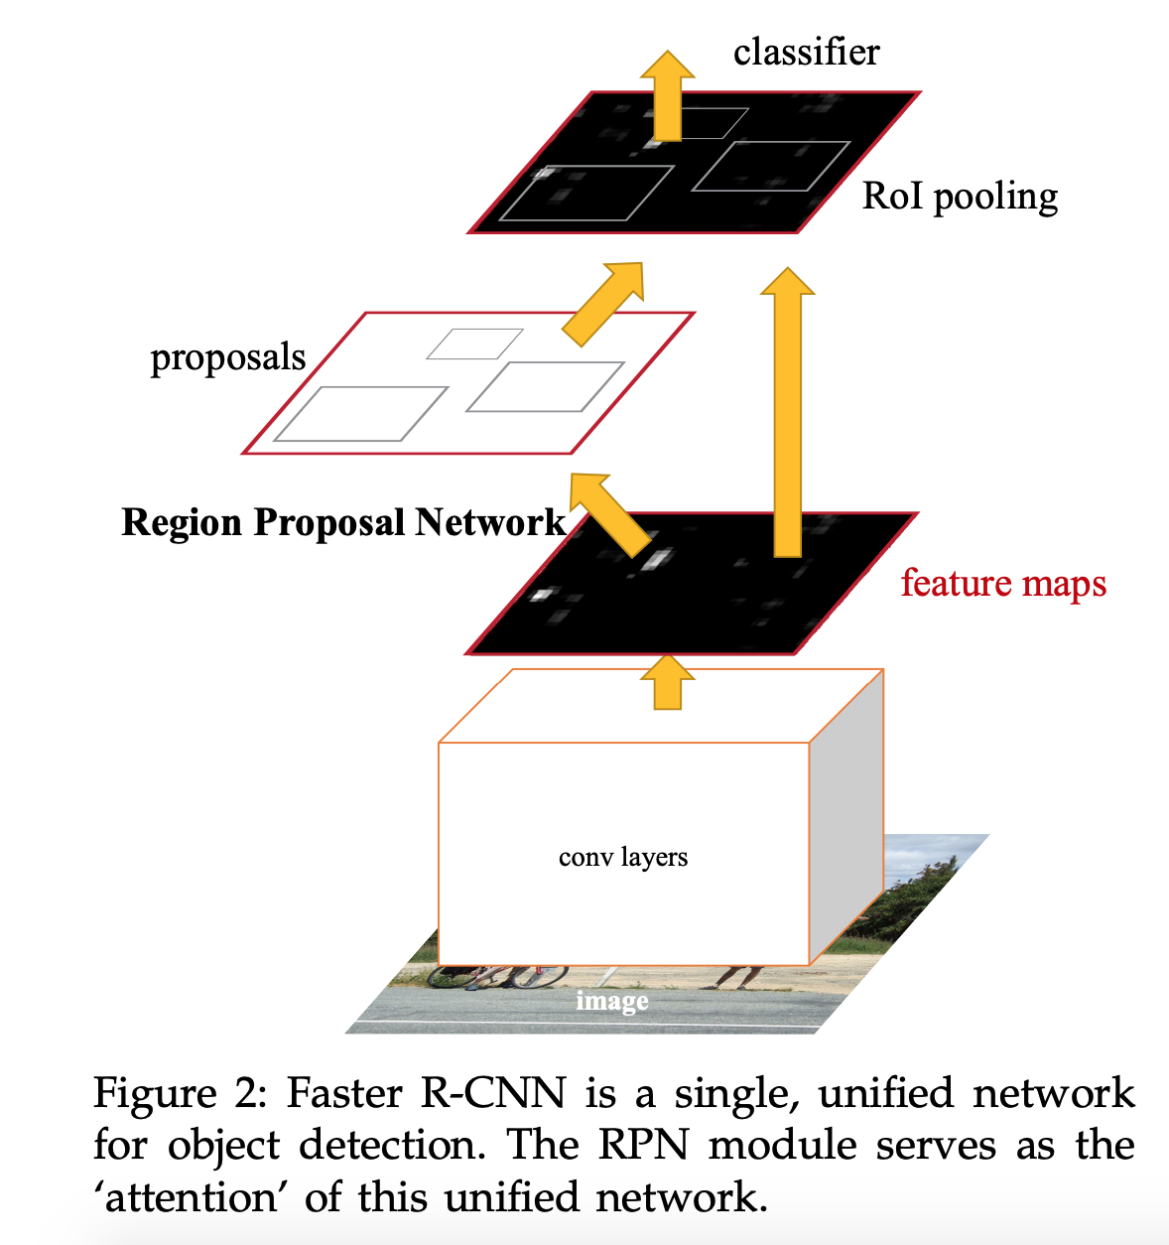
Research and Deep dive into algorithms
Ref - https://arxiv.org/pdf/1506.01497.pdf

Slide 11
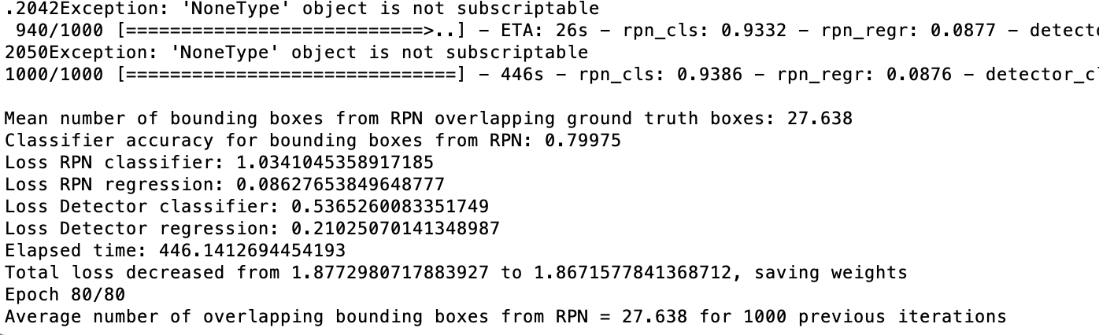
Research and Deep dive into algorithms
FRCNN Training time – 11 Hrs for 80 epoch and 20K images
Tested model for 15 test images.

Slide 12
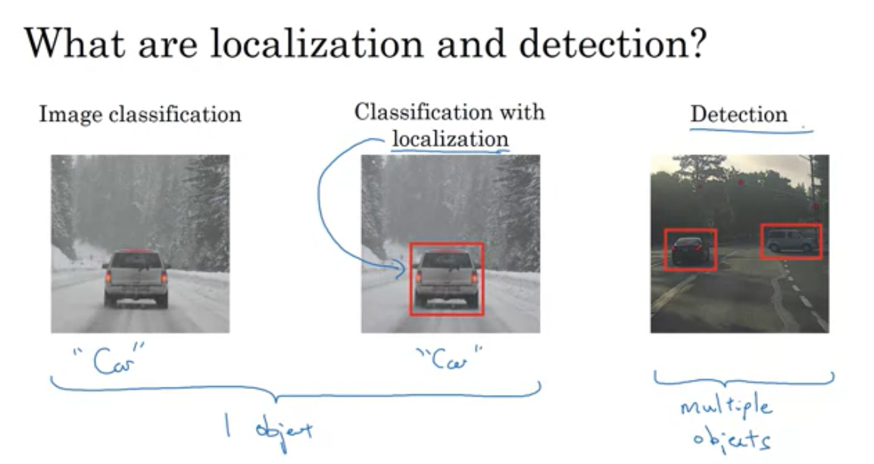
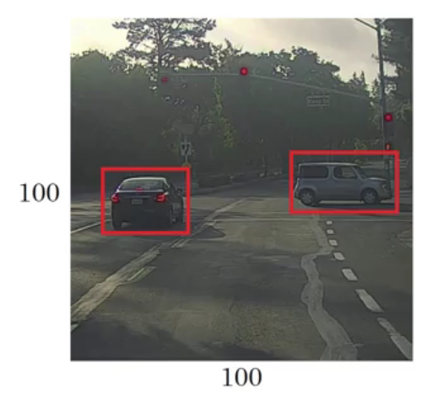
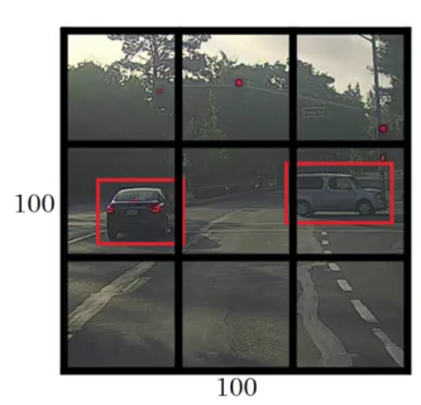
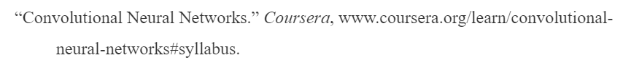
Research and Deep dive into algorithms
YOLO: (You Only Look Once) used for Object Detection – High level Steps
Classification: returns class (output)
Localization: returns class + 4 parameter related to bounded box (bx, by, bh and bw)
Detection: For each cell in grid, returns class + bounded box parameters (x anchor box)
End Goal
Step 1: Split image into grid: here 3x3
Step 2: Each cell is analyzed for mid-point of the object being detected.
Step 3: If detected, bounding boxes are calculated based on that cell.

Slide 13
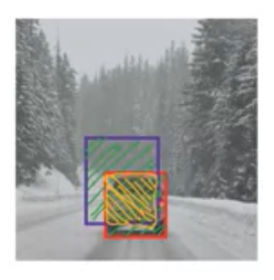
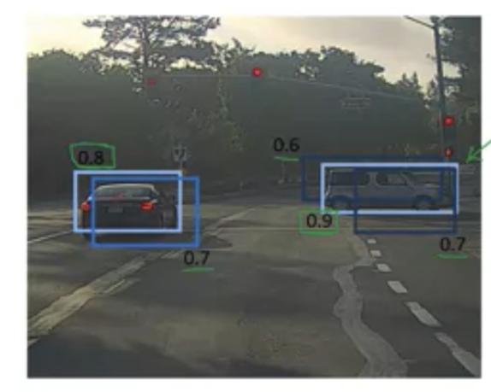
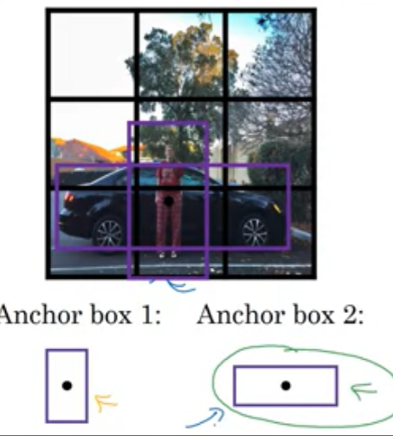
Research and Deep dive into algorithms
YOLO: Additional Notes:
Evaluate Object Localization:
IOU (Intersection over Union) : Calculates overlap between bounding boxes
and uses ratio to determine keep/discard.
Ground Truth = Red box, Algo output: Blue box
In case of multiple detections of same object, use:
Non-Max Suppression: First get rid of all boxes with Prob <6. Then choose
max Prob in a set of predictions for a particular object. Then discard all Probs
below max Prob.
In case of midpoints of objects in same cell, use:
Anchor boxes: Define 5-10 different shape of possible anchors and extend the
y output to capture different anchor shapes

Slide 14
Research and Deep dive into algorithms
YOLO:
Works with Conv Nets that perform classification and localization. Runs with one Conv Net – compared to separate run for each cell or each region. This efficiency allows for real time object detection.
Runs faster than other region based object detection architectures
Outputs better bounding boxes as box is not determined by stride size or window size of sliding windows.
Has trouble detecting multiple objects in a cell (dependent on anchors)
Use Fine grained cells for better detection

Slide 15
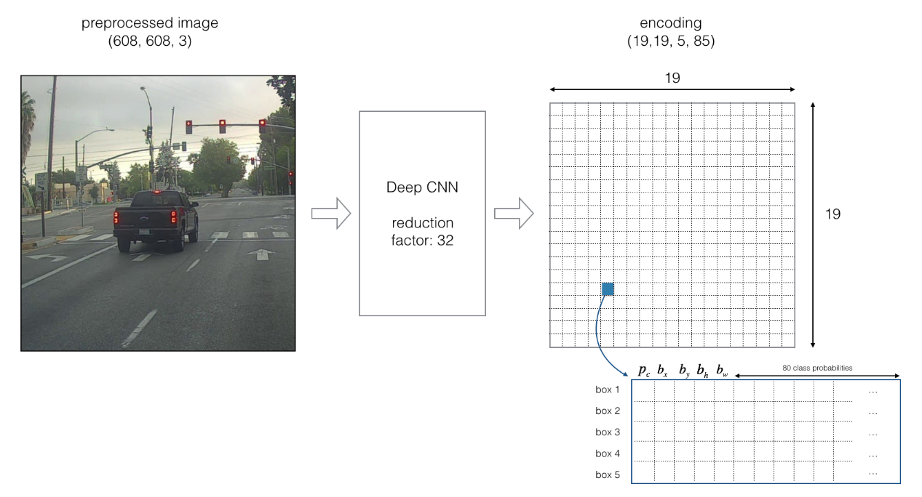
Research and Deep dive into algorithms
YOLO:
https://github.com/enggen/Deep-Learning-Coursera/blob/master/Convolutional%20Neural%20Networks/Week3/Car%20detection%20for%20Autonomous%20Driving/Autonomous%20driving%20application%20-%20Car%20detection%20-%20v1.ipynb

Slide 16
Research and Deep dive into algorithms
SSD (Single Shot MultiBox Detector)
Object localization and classification are done in a single forward pass.
Give better performance and precision for Object detection task.
VGG-16 is used as a base network because of it’s strong performance in high quality image classification task.
MultiBox - A method for fast class-agnostic bounding box coordinate proposals.
multibox_loss = confidence_loss + alpha * location_loss
Confidence Loss: this measures how confident the network is of the objectness of the computed bounding box.
Location Loss: this measures how far away the network’s predicted bounding boxes are from the ground truth ones

Slide 17
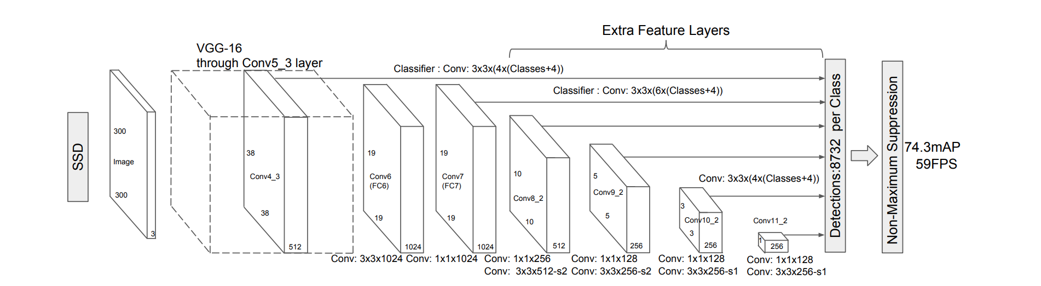
SSD Architecture
Ref - https://arxiv.org/pdf/1512.02325.pdf

Slide 18
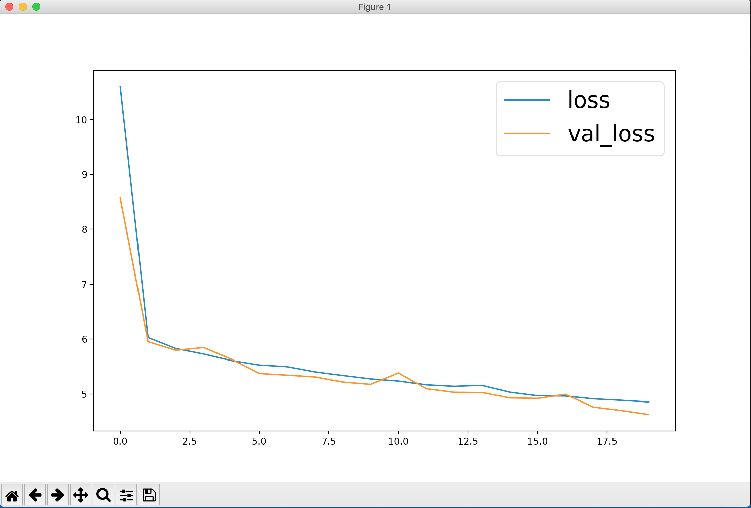
SSD Architecture

Slide 19
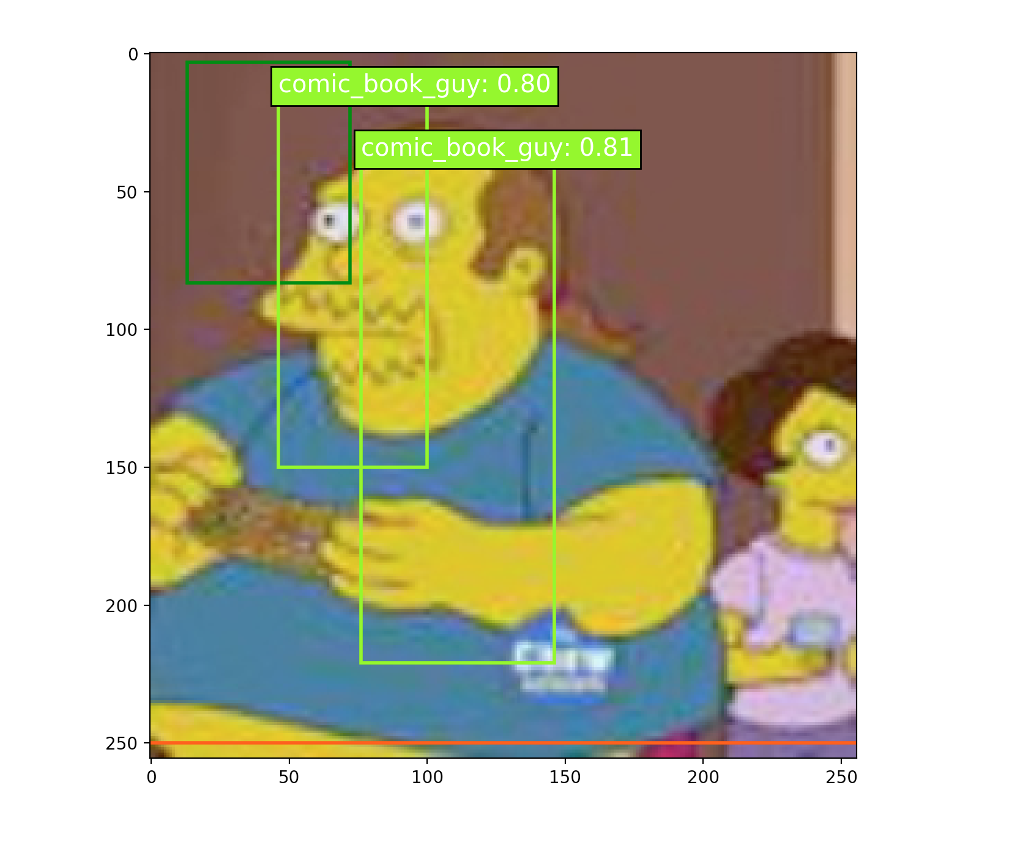
SSD Architecture

Slide 20
Research and Deep dive – TensorBoard (Visualizing Learning)
Brief Overview
Extension of TensorFlow for visualization
Most APIs leave the user with a dilemma: the inner workings of the API are obfuscated and user either has to successfully visualize more of the neural network and input this understanding into the program or only input the less sophisticated, easier to understand portions of the neural network and deal with a confusing, far-from-ideal visualization.
TensorBoard thus makes it possible to visualize the vast quantity of layers and variables involved in deep learning on an informative, yet usable basis.
Different from other visualization tools because it actually bases much of the visualization off of the more elementary, basic structures.
Basics of How TensorBoard Works
Give TensorBoard access to the code (GitHub, Python, etc.)
Acclimate TensorBoard to the names of key variables
Define summaries (these are what TensorBoard understands and interprets when forming the visualization)
Three key coding phases (names quoted from https://www.datacamp.com/community/tutorials/tensorboard-tutorial) a. “Loading data” b. “Training” c. “Validation and Testing”

Slide 21
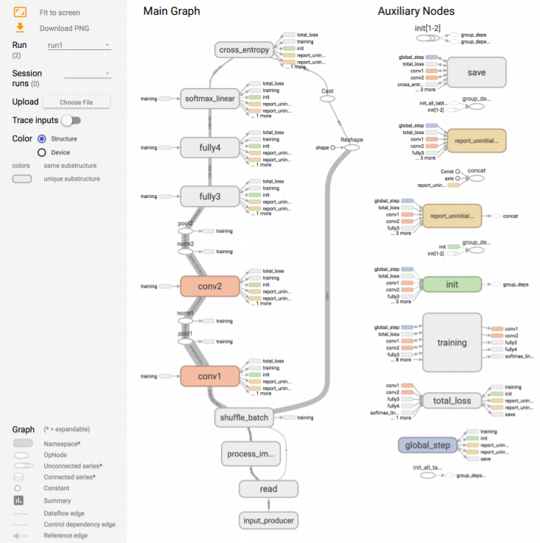
Research and Deep dive – TensorBoard (Visualizing Learning)
https://www.tensorflow.org/guide/summaries_and_tensorboard

Slide 22
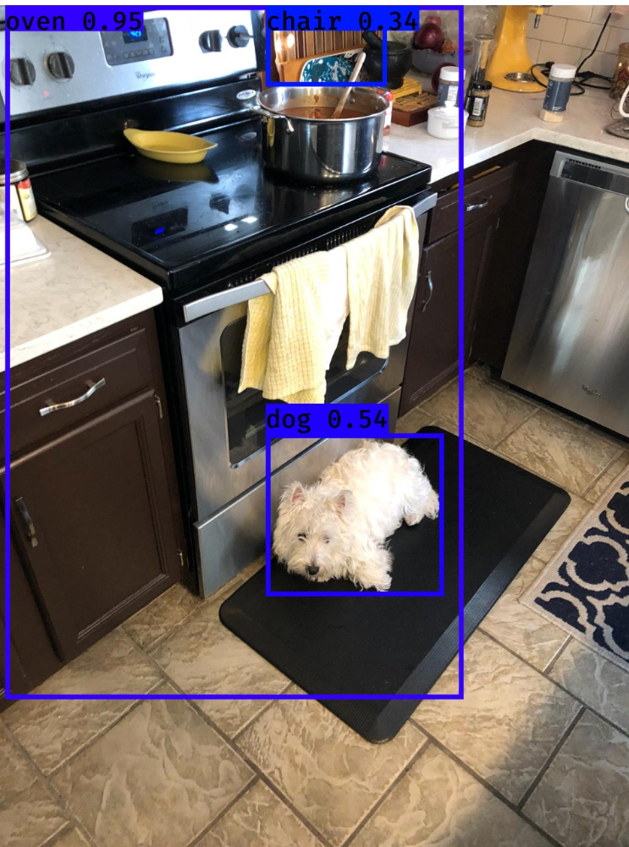
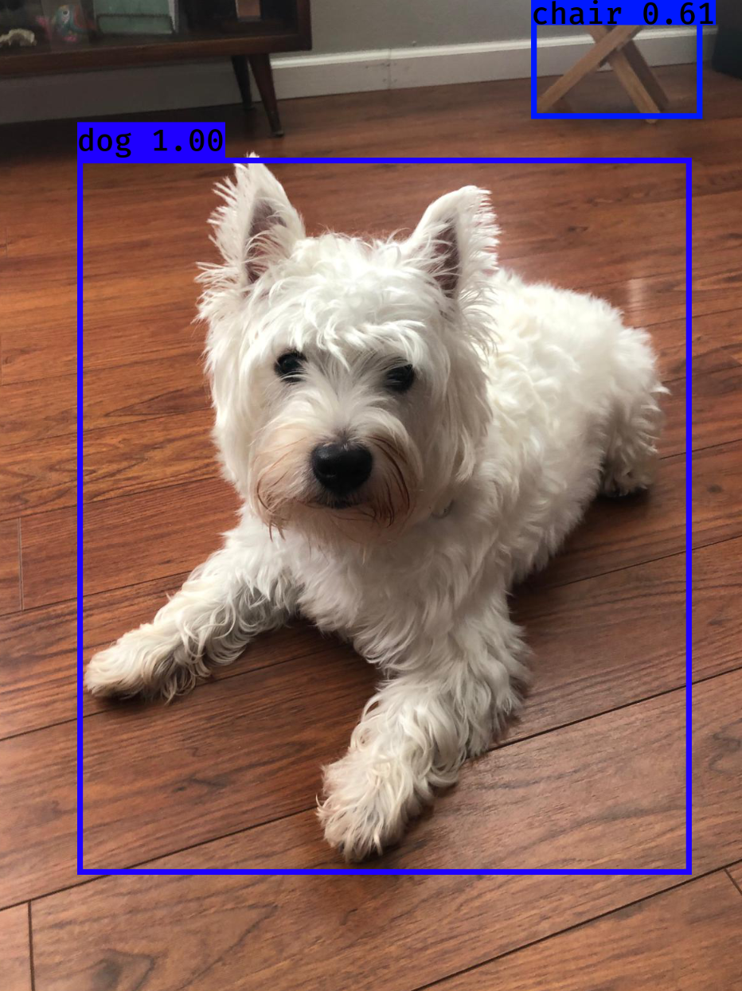
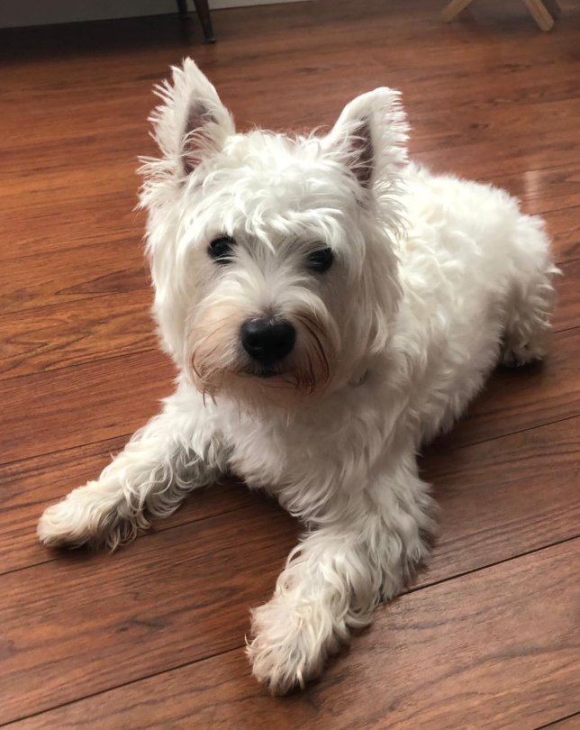
Testing and Validation of models
Run pretrained YOLO v3 on local machine
Used a Keras implementation of YOLO v3 with TensorFlow backend (Source: https://github.com/qqwweee/keras-yolo3)
Uses DarkNet model CFG and weights (pjreddie darknet/yolo). Darknet pretrained 1000 class ImageNet (maybe others).
Ran model to detect “Momo” (“Westie” breed) – image & video
Found 3 boxes for img
oven 0.95 (14, 0) (882, 1314)
chair 0.34 (508, 0) (737, 153)
dog 0.54 (508, 811) (845, 1119)
Found 2 boxes for img
chair 0.61 (851, 0) (1120, 195)
dog 1.00 (136, 257) (1103, 1386)

Slide 23
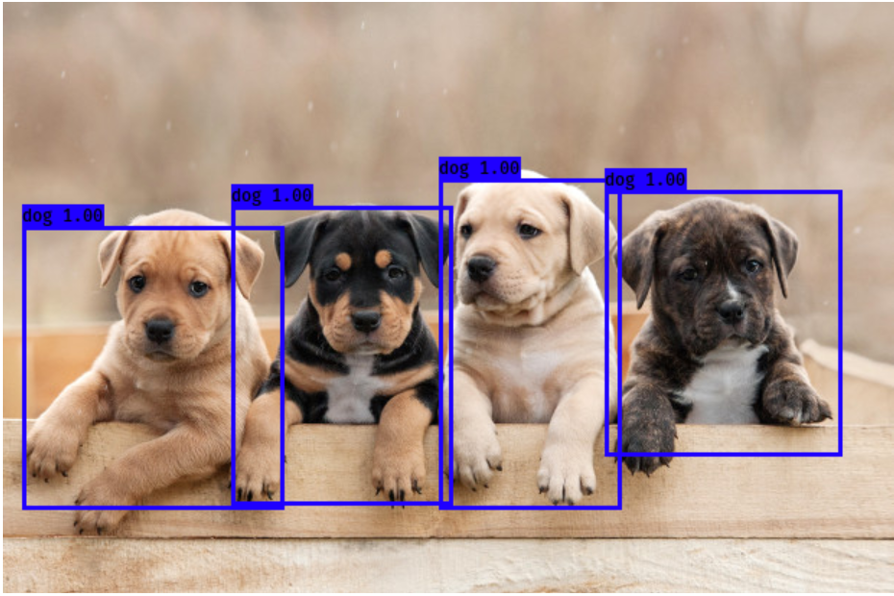
Testing and Validation of models
Run pretrained YOLO v3 on local machine (multiples of same object type)
Found 4 boxes for img
dog 1.00 (158, 141) (311, 348)
dog 1.00 (13, 155) (194, 351)
dog 1.00 (302, 122) (428, 351)
dog 1.00 (417, 130) (581, 314)
https://nypost.com/2018/10/23/a-dogs-color-could-impact-how-long-they-live/ - Image source

Slide 24
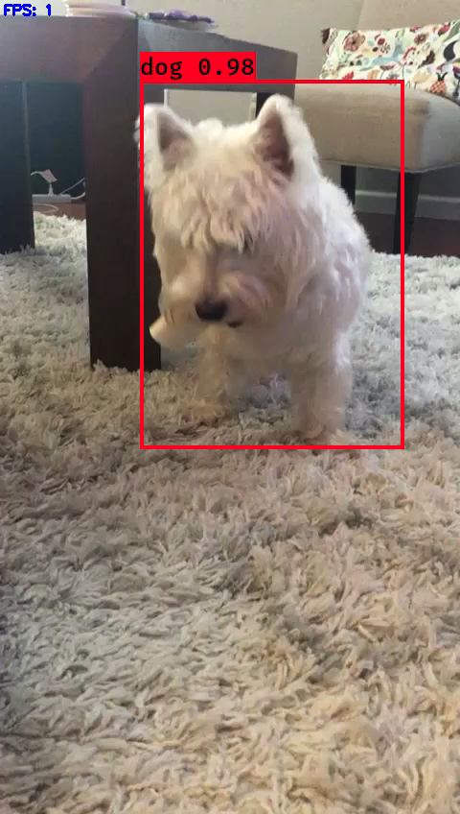
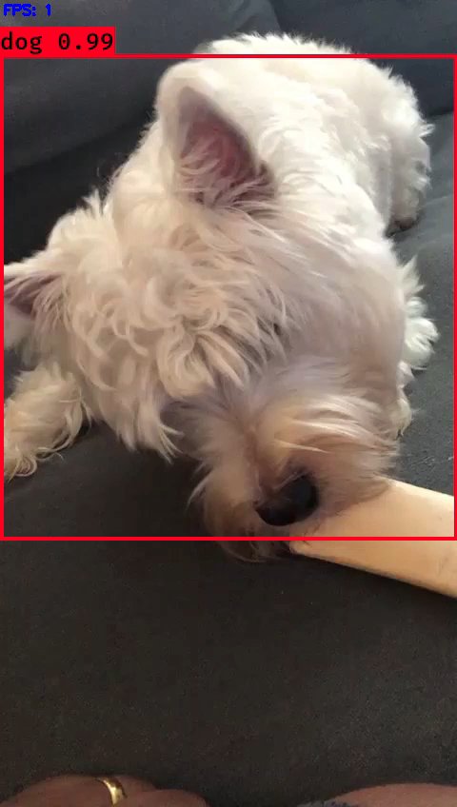
Testing and Validation of models
Video samples

Slide 25
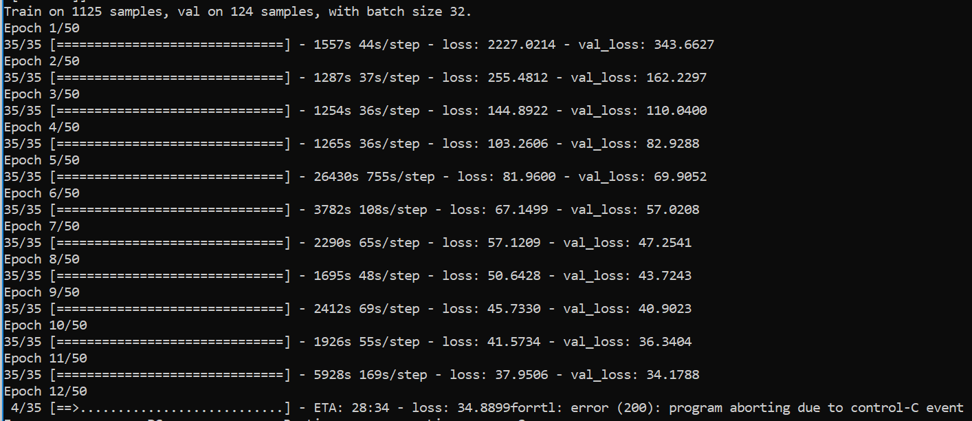
Testing and Validation of models
Attempted training on local machine (No GPU)
Extending DarkNet Yolo v3 to train 3 Simpson characters: 913+623+1342 images
Started training 1342 set = 13 hours (terminated)
All default settings used to train COCO and Pascal VOC retained as is.
Yolo can work with any image size – it retains aspect ratio while resizing

Slide 26
Testing and Validation of models
Update for week of 7/9:
Setup YOLO to run on ARGO
Libraries, code adapted to run on ARGO
Initial training with 3 characters only.
Issues faced:
OOO errors (with Epoch sizes > 25 and Batch Size =96, with training using frozen layers and unfrozen layers
Combination of libraries/modules activated in ARGO
Modified Annotations to conform to YOLO intake format.. RegExp..17 characters have annotations available
Full dataset execution:
6752 images with annotation (image set: 20187)
10 Epochs with Batch size 32 (with all layers -3 frozen), 10 Epochs with Batch size 10 (no frozen layers)
CPU: 3hr 51 mins
Transfer learning
Next set of enhancements : 2 GPUs not utilized(*), non-Transfer learning, increase Epochs

Slide 27
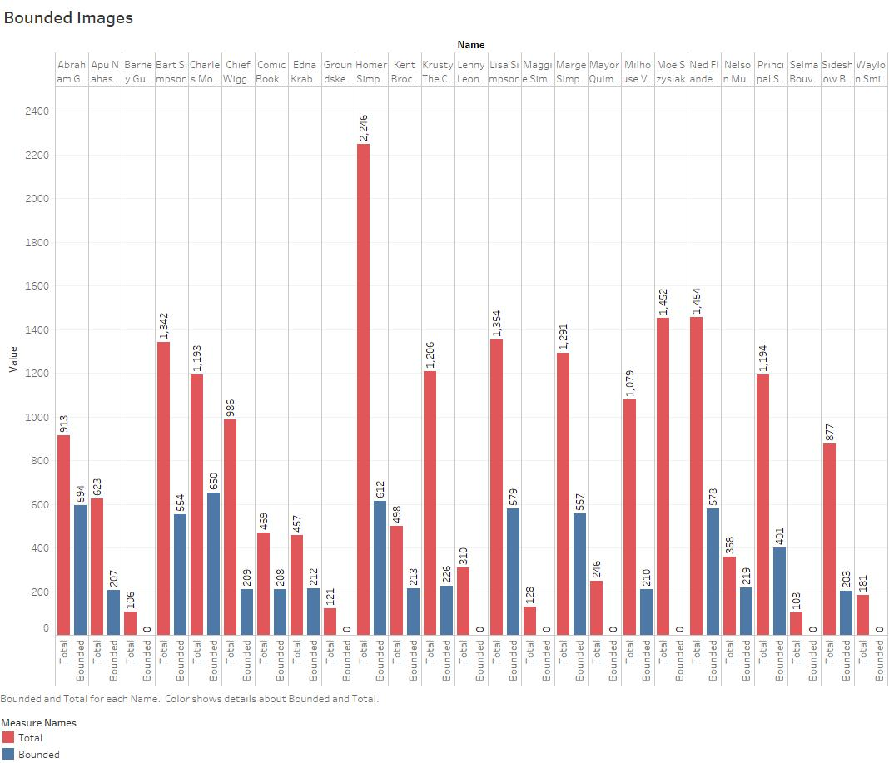
Testing and Validation of models
Update for week of 7/9:

Slide 28
Testing and Validation of models
Update for week of 7/9:
Setup YOLO to run on ARGO
Libraries, code adapted to run on ARGO
Initial training with 3 characters only.
Issues faced:
OOO errors (with Epoch sizes > 25 and Batch Size =96, with training using frozen layers and unfrozen layers
Combination of libraries/modules activated in ARGO
Modified Annotations to conform to YOLO intake format.. RegExp..17 characters have annotations available
Full dataset execution:
6752 images with annotation (image set: 20187)
10 Epochs with Batch size 32 (with all layers -3 frozen), 10 Epochs with Batch size 10 (no frozen layers)
CPU: 3hr 51 mins
Transfer learning
Next set of enhancements : 2 GPUs not utilized(*), non-Transfer learning, increase Epochs , modify image size set prior to training, change training to validation ratio, Understand TensorBoard output

Slide 29
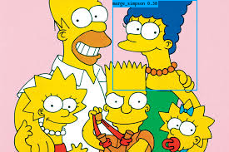
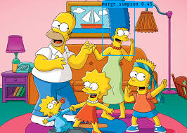
Testing and Validation of models
Update for week of 7/9:
[mprasad4@ARGO-2 mprasad4]$ cat YOLO-Simpsons-MP-NODE050-927356.out
Hello
Image detection mode
Ignoring remaining command line arguments: ./path2your_video,
/scratch/mprasad4/logs/000/trained_weights_final.h5 model, anchors, and classes loaded.
In True
/scratch/mprasad4/SampleData/simpsons4.jpg
in else
(416, 416, 3)
Found 1 boxes for img
marge_simpson 0.45 (145, 1) (191, 79)
7.015773432329297
[mprasad4@ARGO-2 mprasad4]$ cat YOLO-Simpsons-MP-NODE050-927354.out
Hello
Image detection mode
Ignoring remaining command line arguments: ./path2your_video,
/scratch/mprasad4/logs/000/trained_weights_final.h5 model, anchors, and classes loaded.
In True
/scratch/mprasad4/SampleData/simpsons2.jpg
in else
(416, 416, 3)
Found 1 boxes for img
marge_simpson 0.38 (135, 0) (236, 108)
3.9776098411530256

Slide 30
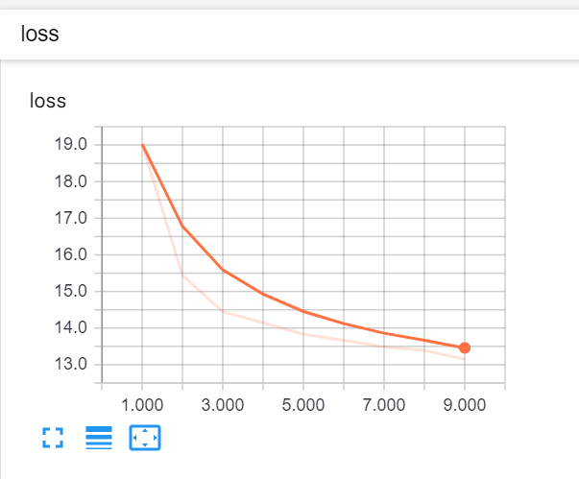
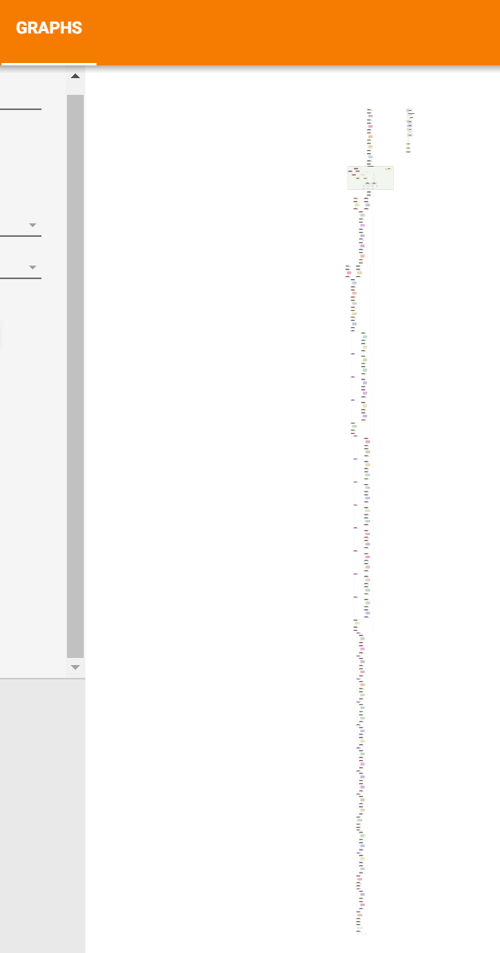
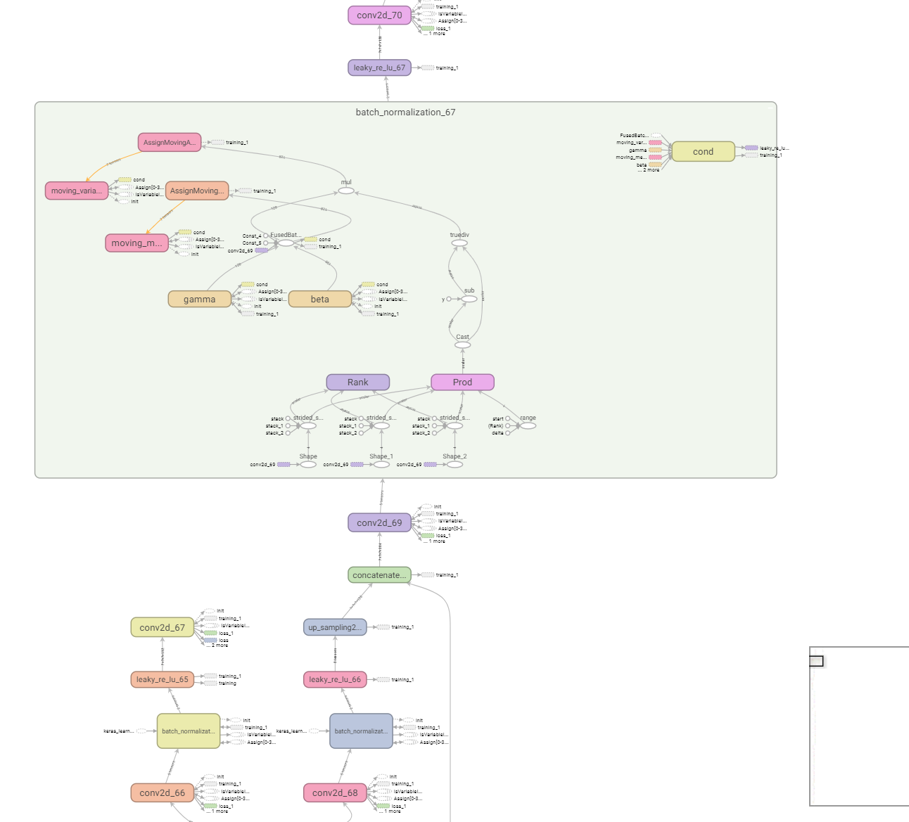
Metrics used to assert results

Slide 31
Metrics used to assert results

Slide 32
Incremental Results

Slide 33
Visualizations

Slide 34
Understanding of Potential Algorithms
SafariBooksOnline
Deep Learning with TensorFlow: Applications of Deep Neural Networks to Machine Learning Task – Jon Krohn
Previous coursework material – GMU CS580 (attended by team member)
Publication/Articles
https://blog.keras.io/building-powerful-image-classification-models-using-very-little-data.html
https://machinelearningmastery.com/cnn-long-short-term-memory-networks/
https://blog.algorithmia.com/introduction-to-deep-learning/
https://link.springer.com/chapter/10.1007/978-3-030-01424-7_25
https://arxiv.org/abs/1512.03385

Slide 35
Mathematics and Statistics supporting algorithms

Slide 36
Implementation and Comparison of algorithms

